Slide 1

Hit Rate-
Design of Experiment
BIA-654 project
Instructor:
Dr. Chihoon Lee
Team members:
Qian Lu
Yang Wu
Rumeng Zuo
Haodong Zhao

Slide 2
Introduction
Topic selection
  Playing basketball, a popular game raises our group members interest.
  Field test is more convincing
Objective
  Find out significant factors to assist players practice playing basketball efficiently
Guideline of Experiment
  Data collection from gym
  Data process in JMP
  Results analysis
Conclusion
2

Slide 3
Factors
Factors | + | -
Posture | Jump | No Jump
Defense | With defense | Without defense
Location | Penalty line | Low post
Hands | One hand | Two hands
Ball | Basketball | Football

Slide 4
Experiment Methods
Method used
  Fractional factorial design
    Response: Successful hits
    Number of observations: 32
Replicates
  We have one replication in this experiment
  20 hits in total for each pattern
Blocks
  We set four people as four blocks

Slide 5
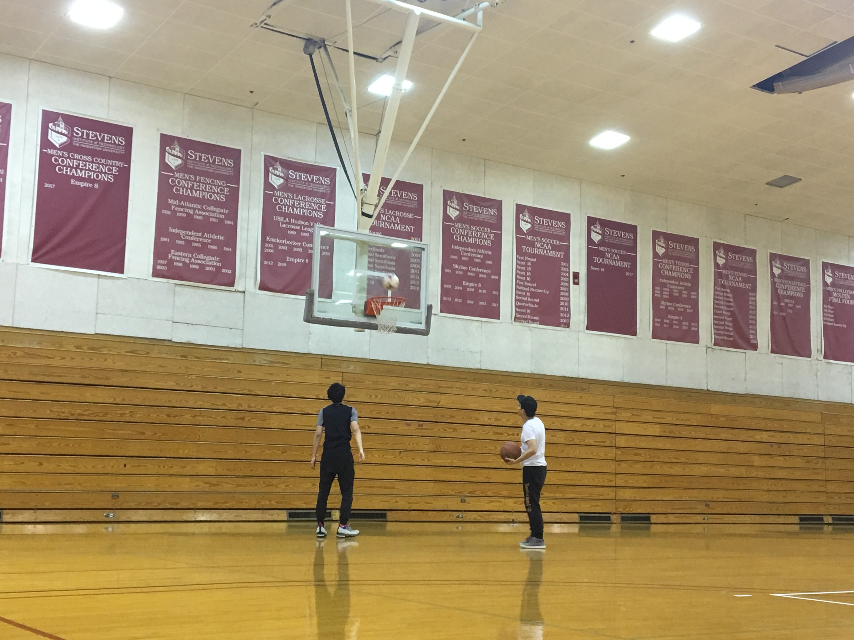
Data Collection
Experiment place
  Stevens gym
Number of people：4

Slide 6
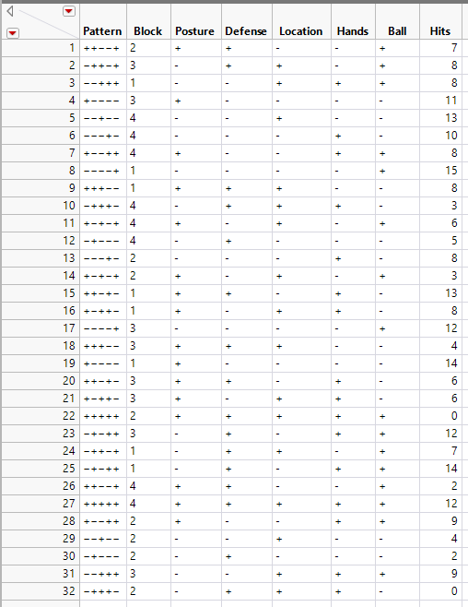
Data

Slide 7
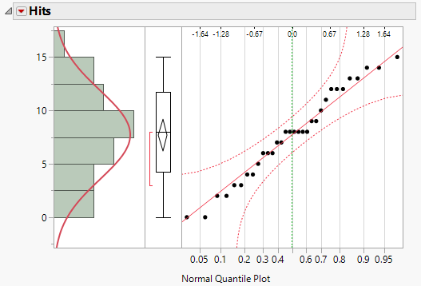
Experiment Results
Normal Quantile Plot

Slide 8
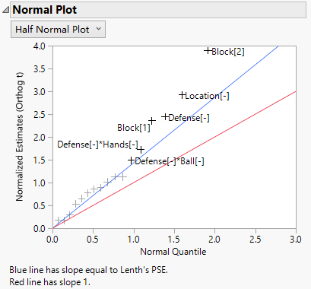
Experiment Results
Half Normal Plot

Slide 9
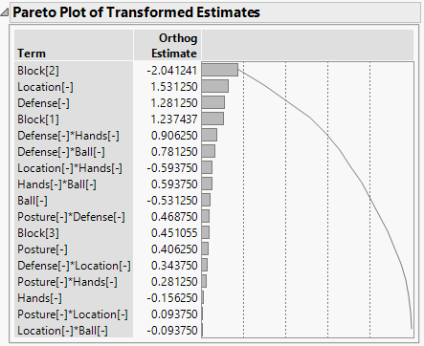
Experiment Results
Pareto Plot of Estimates
80/20 Rule:
    Location
    Defense
    Defense*Hands

Slide 10
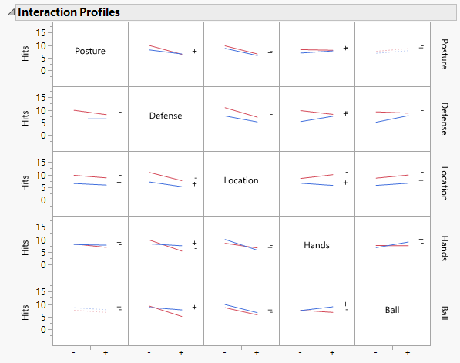
Experiment Results
Interaction Plot

Slide 11
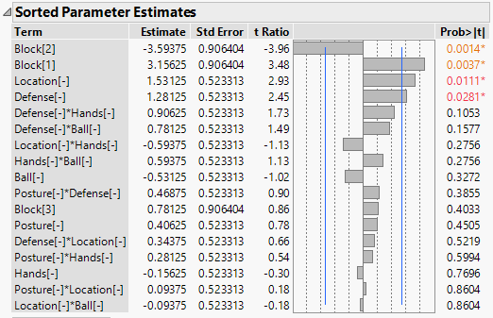
Experiment Results

Slide 12
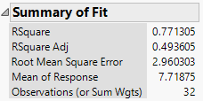
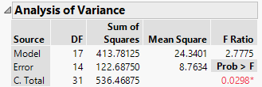
Experiment Results

Slide 13
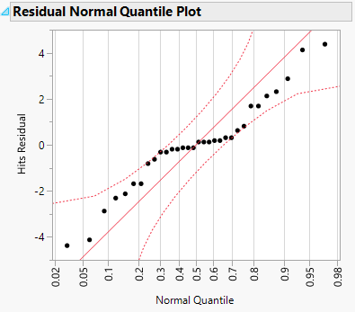
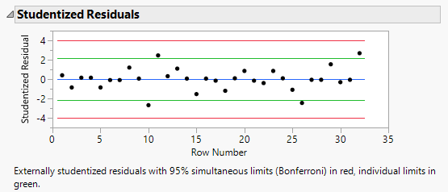
Experiment Results
Residual Analysis

Slide 14
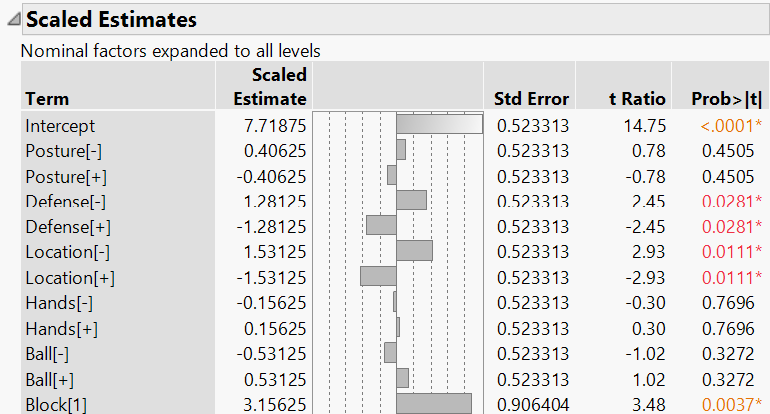
Conclusion
Predicted Regression Line
Y=7.71875-1.53125*Location-1.2815*Defense
Rating max:
Location(-) Defense(-)
=10.5315

